Slide 1
Tower of Hanoi

Slide 2
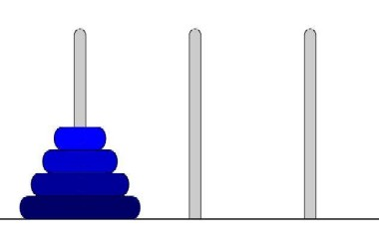
Tower of Hanoi
Tower of Hanoi is a mathematical puzzle invented by a French Mathematician Edouard Lucas in 1883.
Tower of Hanoi (also called The problem of Benares Temple or Tower of Brahma or Lucas Tower or pyramid puzzle.
The game starts by having few discs stacked in increasing order of size. The number of discs can vary, but there are only three pegs.

Slide 3
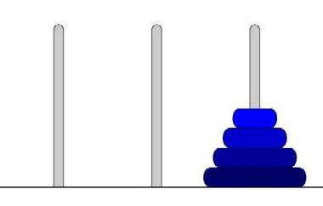
Tower of Hanoi
The Objective is to transfer the entire tower to one of the other pegs. However you can only move one disk at a time and you can never stack a larger disk onto a smaller disk. Try to solve it in fewest possible moves.

Slide 6
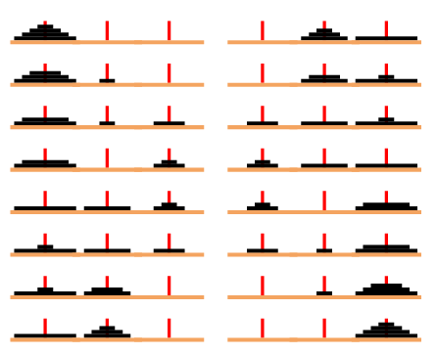
Tower of Hanoi
How to solve the 4 discs

Slide 7
Tower of Hanoi
Recursive Solution for the Tower of Hanoi with algorithm.
Let’s call the three peg Src(Source), Aux(Auxiliary) and Dst(Destination).
  Move the top N – 1 disks from the Source to Auxiliary tower.
  Move the Nth disk from Source to Destination tower.
  Move the N – 1 disks from Auxiliary tower to Destination tower. Transferring the top N – 1 disks from Source to Auxiliary tower can again be thought of as a fresh problem and can be solved in the same manner.

Slide 8
Tower of Hanoi
TOWER(N, BEG, AUX, END)
1. If N = 1 then
Move 1 disc from BEG --> END
  return
2. [Move N-1 disks from peg BEG to peg AUX]
Call TOWER(N-1, BEG, END, AUX)
Move 1 disc from BEG --> END
[Move N-1 disks from peg AUX to peg END]
Call TOWER(N-1, AUX, BEG, END)
5. Return.

Slide 9
1. Tower(n-1, BEG, END,AUX)
2. Tower(1, BEG, AUX, END) move BEG→ END
3. Tower(n-1, AUX, BEG, END)

Slide 10
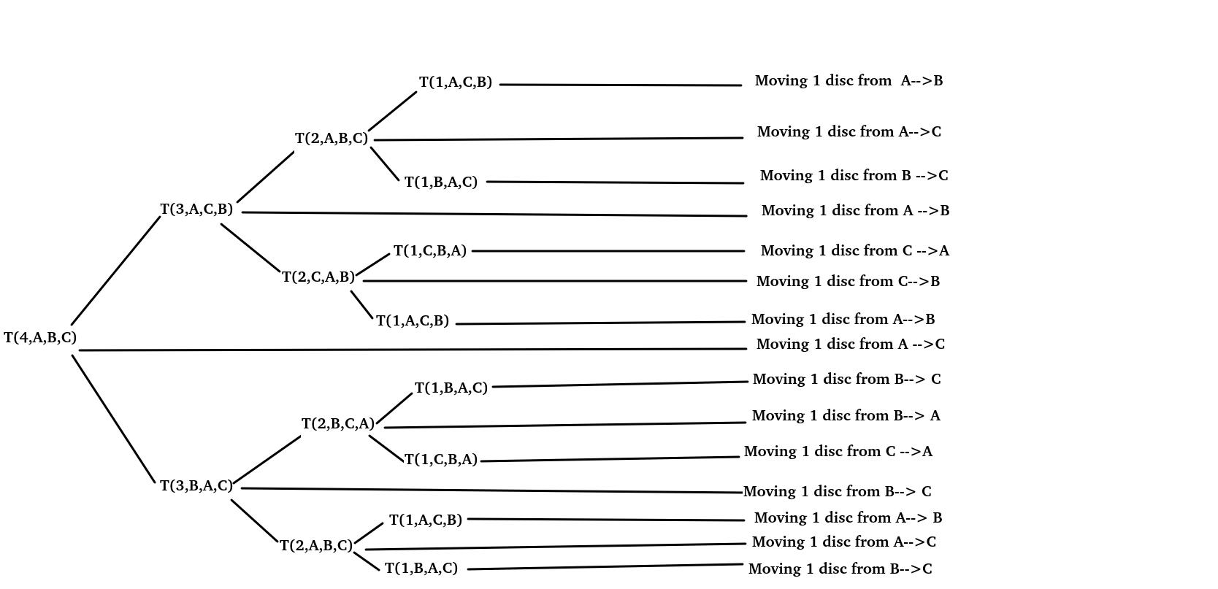

Slide 11
#include<iostream>
using namespace std;
int cnt=0;
void toh(int n, char a, char b ,char c)
{
if(n==1){
cout<<++cnt<<" move 1 disc from "<<a<<" to "<<c<<"\n";return;
}
else
{
toh(n-1,a,c,b);
cout<<++cnt<<" move 1 disc from "<<a<<" to "<<c<<"\n";
toh(n-1,b,a,c);
}
}
int main()
{
toh(3,'A','B','C');
}

Slide 12
The optimal data structure used to solve Tower of Hanoi is _________
a) Tree
b) Heap
c) Priority queue
d) Stack

Slide 13
Tower of Hanoi
Explicit Pattern
Number of Disks Number of Moves
1 1
2 3
3 7
4 15
5 31
Powers of two help reveal the pattern:
Number of Disks (n) Number of Moves
1 2^1 - 1 = 2 - 1 = 1
2 2^2 - 1 = 4 - 1 = 3
3 2^3 - 1 = 8 - 1 = 7
4 2^4 - 1 = 16 - 1 = 15
5 2^5 - 1 = 32 - 1 = 31

Slide 14
What is the number of moves required to solve Tower of Hanoi problem for k disks?
a) 2k – 1
b) k^2 - 1
c) 2^{k} + 1
d) 2^{k} – 1

Slide 15
Thank You

